Slide 1
secure data hiding in images using steganography
Presented By: Shilpa Pagadala
College Name: Megha Institute of Engineering and Technology for Women
Department : BTech ( Computer Science and Engineering)

Slide 2
OUTLINE
Problem Statement
Technology used
Wow factor
End users
Result
Conclusion
Git-hub Link
Future scope

Slide 3
Problem Statement
In the digital age, safeguarding sensitive information from unauthorized access is paramount. Traditional encryption can attract unwanted attention, making hidden messages susceptible to interception. This project aims to develop a steganography-based secure data hiding system that embeds secret messages within images without visibly altering them.
By utilizing the Least Significant Bit (LSB) technique, the system keeps confidential data undetectable while preserving the image's original quality. This method offers a covert communication channel for secure information transfer, making it perfect for cybersecurity, watermarking, and confidential messaging applications

Slide 4
Technology used
Python – The core programming language used.
Tkinter – Used for the graphical user interface (GUI).
PIL (Pillow) – Used for image processing (opening, modifying, and saving images).
Bit Manipulation - Encoding and decoding the hidden message using binary operations.
SYSTEM REQUIREMENTS:
Operating System: Windows, macOS, or Linux
Python Version: Python 3.xRequired
RAM: At least 2GB RAM, but 4GB or more is recommended for better performance.

Slide 5
Wow factors
Uses LSB (Least Significant Bit) Steganography to hide and retrieve messages in images
Simple and easy-to-use GUI interface.
Works without requiring complex encryption methods
Simple yet effective data hiding technique.
Completely invisible to the human eye.

Slide 6
End users
Individuals looking for secure communication
Journalists and activists who need to hide sensitive messages.
Developers interested in steganography
Cybersecurity enthusiasts exploring data hiding techniques.

Slide 7
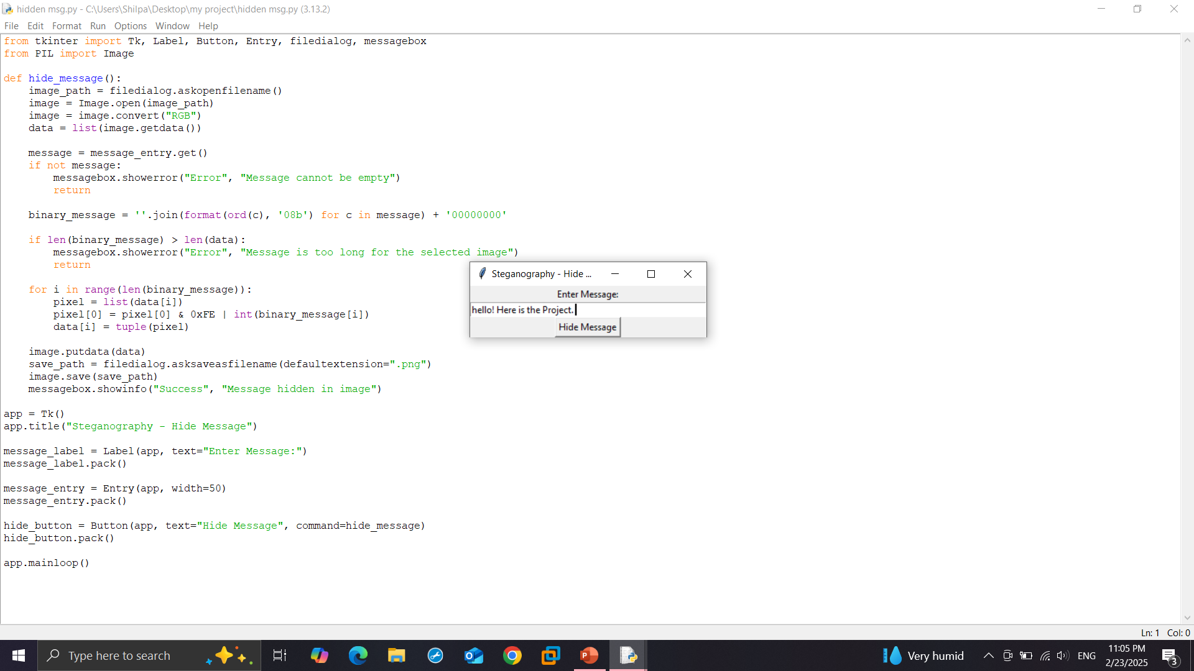
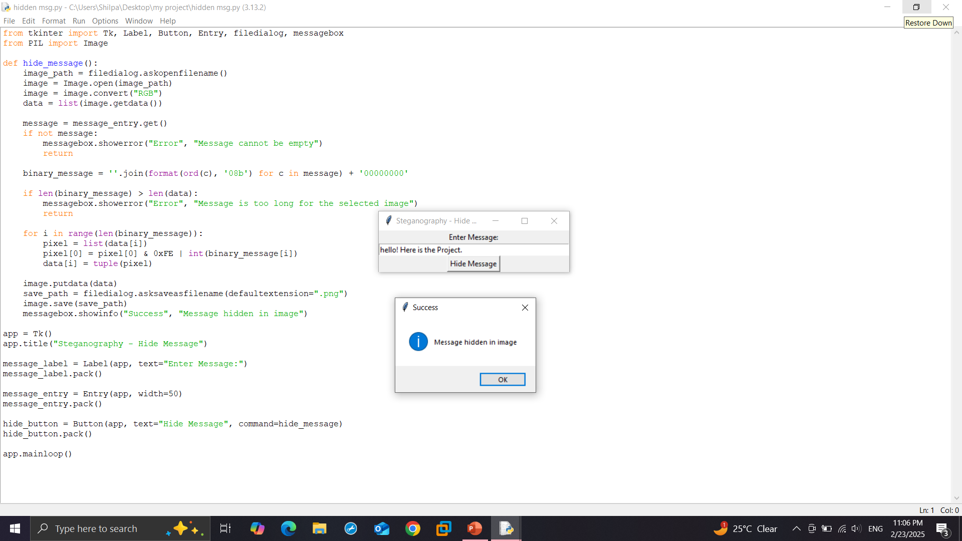
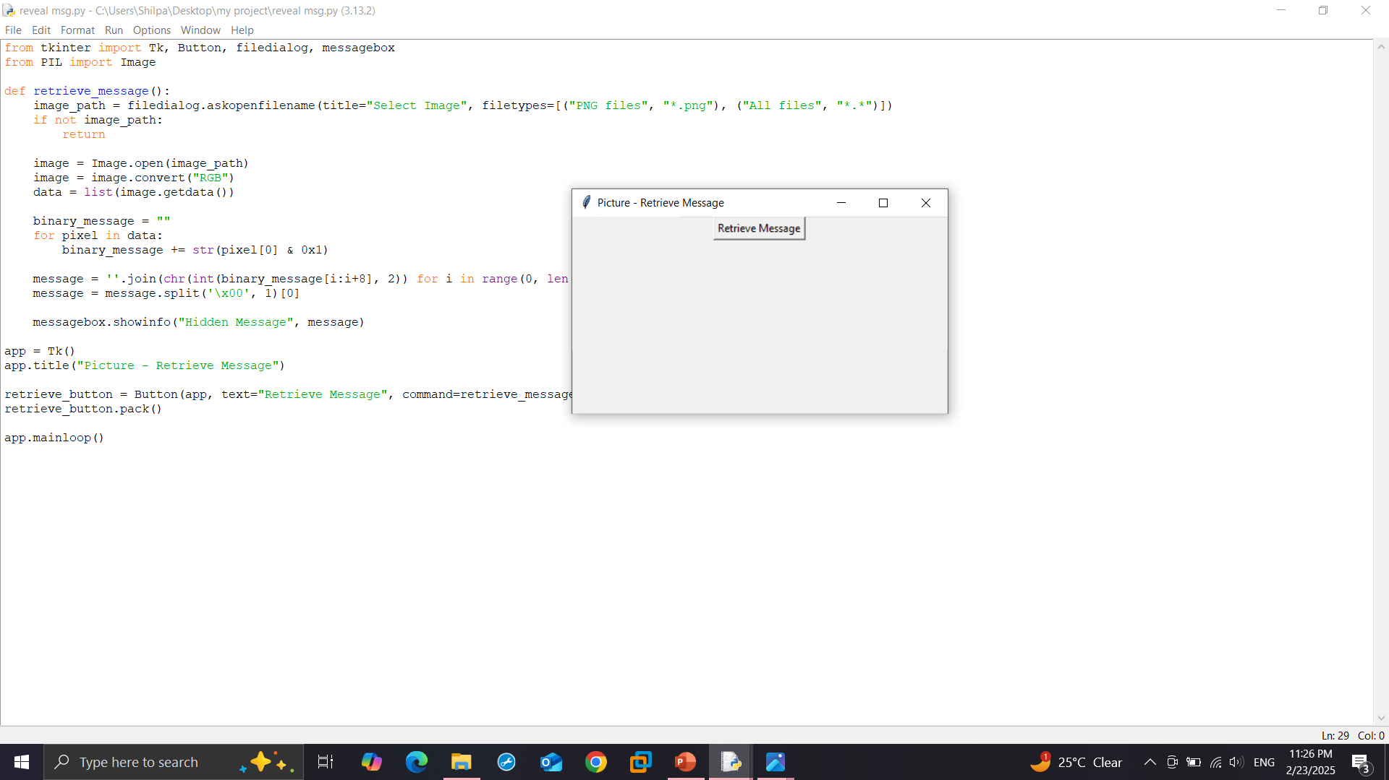
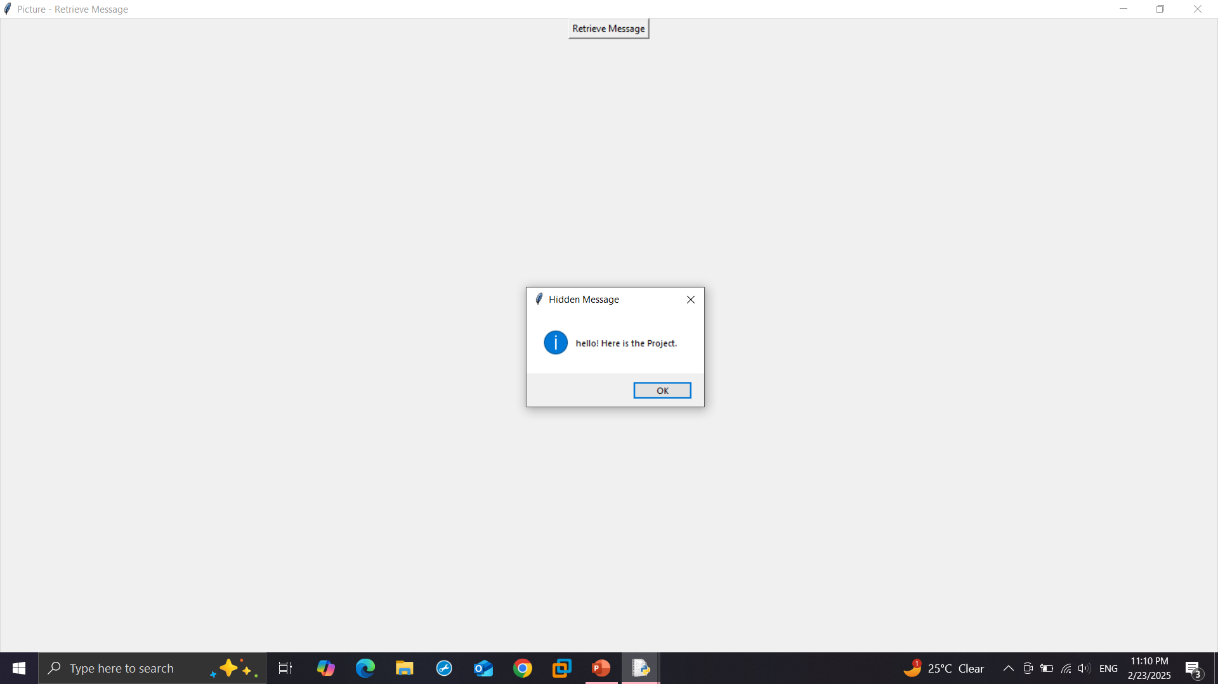
Results

Slide 8
Conclusion
This Project delivered a straightforward, Python-based steganography application with a very robust graphical interface. It simplifies the process of embedding and extracting concealed information in images, offering possibilities for communication and content protection.
This work provides a stepping stone for enhancing confidentiality and data safety in modern networks.

Slide 9
GitHub Link
https://github.com/shilpa724/-Steganography-Project.git

Slide 10
Future scope
Enhanced Security & Encryption: Strengthen encryption and improve resistance against steganalysis and cyber threats.
Support for More File Formats: Extend steganography to videos, audio, and text for secure communication across various media.
Real-time & Cloud Integration: Develop mobile/web applications for instant secure messaging and explore blockchain for decentralized data hiding.
Advanced AI-Powered Techniques: Implement AI for intelligent embedding, detection avoidance, and adaptability against security threats.

Slide 11
THANK YOU

